Slide 1












2023 Recap

Slide 2
CONTENT
01
Accidental invention
02
First foods cooked
Early models were huge
04
Home use came later
03
How it works
Safety myth
05
06

Slide 3

2023, the hottest year ever recorded
Warmer than usual
2 degrees
Cause
Consequences

Slide 4
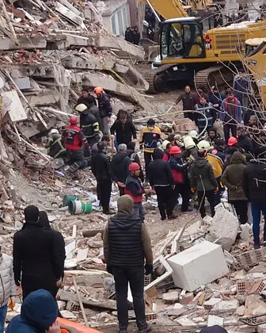
Turkey and Syria were struck by an earthquake
6th February
10,000 aftershocks
50,000 Deaths
Biggest earthquake

Slide 5
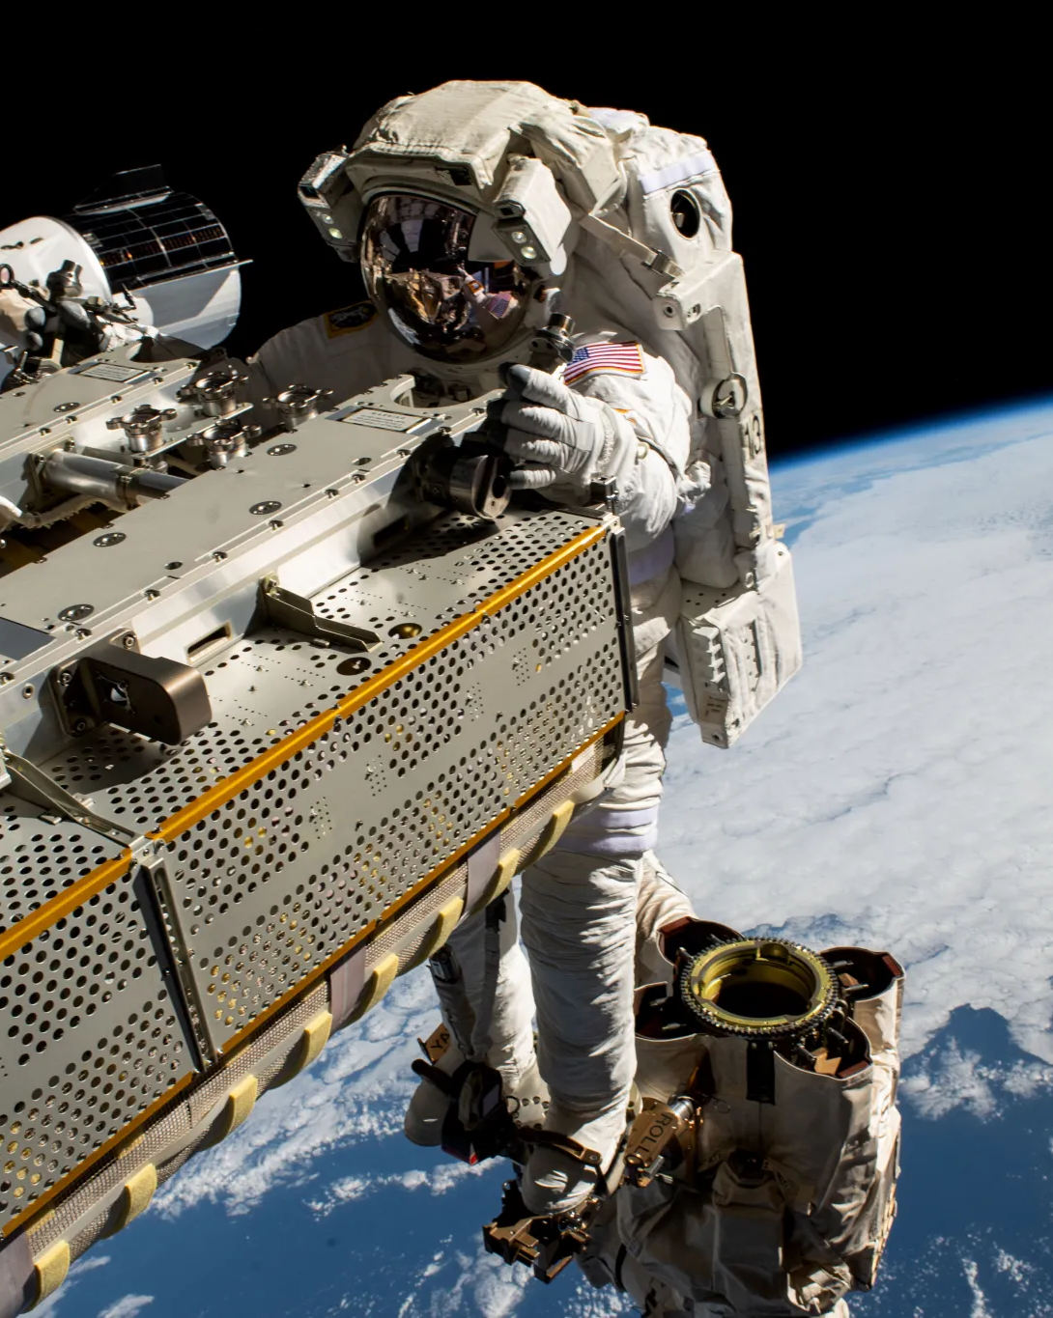

Nasa moonlanding
April 03 -23
Artemis II
Artemis II commander
Pilot
Mission specialist
2025

Slide 6

Finland entered nato
4th April
Western defensive aliance
Number of states to 31
Alexander Stubb
Russian troops

Slide 7


Ai discovery
60 years
6th december
Massachusetts Institute of Technology
Drug resistant
Superbug
MRSA
35 000 per year

Slide 8
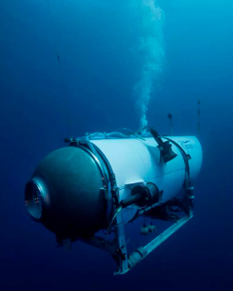
The Oceangate incident
Went bye bye on june 16
Goal was the titanic
They missing
96 hours of oxygen
It go boom and they die

Slide 9



THANKS for watching!

